Slide 1
Anatomy of a Java program
Seminar 1 · Java basics
Tracing Welcome.java, the language basics, and the three kinds of errors
Object-Oriented Programming · Alba Meca

Slide 2
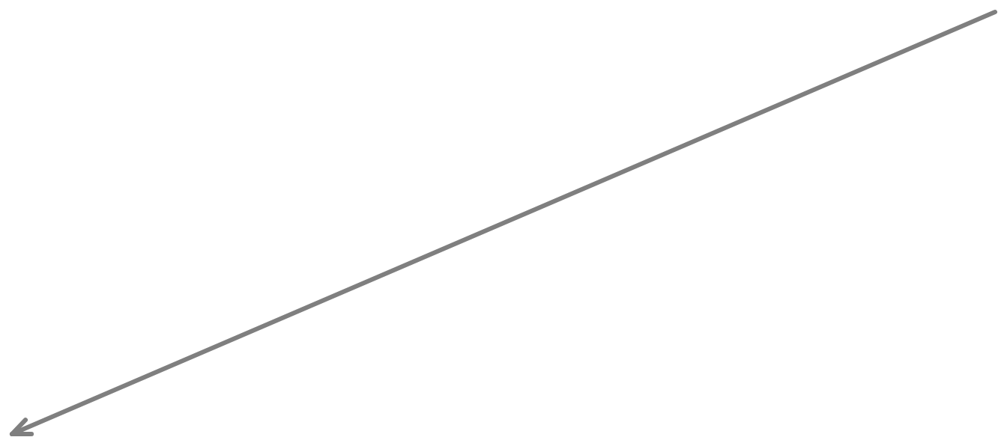
Trace a Program Execution
Enter main method
// This program prints Welcome to Java!
public class Welcome {
public static void main(String[] args) {
System.out.println("Welcome to Java!");
}
}
OOP · Lab 1 · Java basics · 2
Notes:
Step 1: execution enters the main method.

Slide 3

Trace a Program Execution
Execute statement
// This program prints Welcome to Java!
public class Welcome {
public static void main(String[] args) {
System.out.println("Welcome to Java!");
}
}
OOP · Lab 1 · Java basics · 3
Notes:
Step 2: the statement runs.

Slide 4

// This program prints Welcome to Java!
public class Welcome {
public static void main(String[] args) {
System.out.println("Welcome to Java!");
}
}
Command Prompt
C:\book>java Welcome
Welcome to Java!
C:\book>
print a message to the console
OOP · Lab 1 · Java basics · 4
Notes:
Step 3: the message appears in the console.

Slide 5
Class Name
Every Java program must have at least one class. Each class has a name. By convention, class names start with an uppercase letter. In this example, the class name is Welcome.
// This program prints Welcome to Java!
public class Welcome {
public static void main(String[] args) {
System.out.println("Welcome to Java!");
}
}
OOP · Lab 1 · Java basics · 5
Notes:
Class names start with an uppercase letter.

Slide 6
Main Method
Line 2 defines the main method. In order to run a class, the class must contain a method named main. The program is executed from the main method.
// This program prints Welcome to Java!
public class Welcome {
public static void main(String[] args) {
System.out.println("Welcome to Java!");
}
}
OOP · Lab 1 · Java basics · 6
Notes:
The program is executed from main.

Slide 7
1 public class Welcome {
The program starts the execution from the main method.
2 public static void main(String[] args) {
3 // Display message Welcome to Java! on the console
4 System.out.println("Welcome to Java!");
5 }
6 }
OOP · Lab 1 · Java basics · 7

Slide 8
1 public class Welcome {
2 public static void main(String[] args) {
3 // Display message Welcome to Java! on the console
4 System.out.println("Welcome to Java!");
5 }
6 }
The statement displays Welcome to Java! to the console.
Output
Welcome to Java!
OOP · Lab 1 · Java basics · 8

Slide 9
1 public class Welcome {
2 public static void main(String[] args) {
3 // Display message Welcome to Java! on the console
4 System.out.println("Welcome to Java!");
5 }
6 }
The main method exits. The program is finished.
OOP · Lab 1 · Java basics · 9

Slide 10
Statement
A statement represents an action or a sequence of actions. The statement System.out.println("Welcome to Java!") in the program in Listing 1.1 is a statement to display the greeting "Welcome to Java!".
// This program prints Welcome to Java!
public class Welcome {
public static void main(String[] args) {
System.out.println("Welcome to Java!");
}
}
OOP · Lab 1 · Java basics · 10
Notes:
A statement is one action.

Slide 11
Statement Terminator
Every statement in Java ends with a semicolon (;).
// This program prints Welcome to Java!
public class Welcome {
public static void main(String[] args) {
System.out.println("Welcome to Java!");
}
}
OOP · Lab 1 · Java basics · 11
Notes:
Every statement ends with a semicolon.

Slide 12
Reserved words
Reserved words or keywords are words that have a specific meaning to the compiler and cannot be used for other purposes in the program. For example, when the compiler sees the word class, it understands that the word after class is the name for the class.
// This program prints Welcome to Java!
public class Welcome {
public static void main(String[] args) {
System.out.println("Welcome to Java!");
}
}
OOP · Lab 1 · Java basics · 12
Notes:
Reserved words: public, class, static, void.

Slide 13

Blocks
A pair of braces in a program forms a block that groups components of a program.
public class Test {
public static void main(String[] args) {
Method block
System.out.println("Welcome to Java!");
Class block
}
}
OOP · Lab 1 · Java basics · 13
Notes:
Class block and method block.

Slide 14
Special Symbols
Character | Name | Description
{} | Opening and closing braces | Denotes a block to enclose statements.
() | Opening and closing parentheses | Used with methods.
[] | Opening and closing brackets | Denotes an array.
// | Double slashes | Precedes a comment line.
" " | Opening and closing quotation marks | Enclosing a string (i.e., sequence of characters).
; | Semicolon | Marks the end of a statement.
OOP · Lab 1 · Java basics · 14
Notes:
The next slides highlight each symbol in the Welcome program.

Slide 15
{ … }
// This program prints Welcome to Java!
public class Welcome {
public static void main(String[] args) {
System.out.println("Welcome to Java!");
}
}
OOP · Lab 1 · Java basics · 15
Notes:
Braces: blocks.

Slide 16
( … )
// This program prints Welcome to Java!
public class Welcome {
public static void main(String[] args) {
System.out.println("Welcome to Java!");
}
}
OOP · Lab 1 · Java basics · 16
Notes:
Parentheses: used with methods.

Slide 17
;
// This program prints Welcome to Java!
public class Welcome {
public static void main(String[] args) {
System.out.println("Welcome to Java!");
}
}
OOP · Lab 1 · Java basics · 17
Notes:
Semicolon: end of statement.

Slide 18
// …
// This program prints Welcome to Java!
public class Welcome {
public static void main(String[] args) {
System.out.println("Welcome to Java!");
}
}
OOP · Lab 1 · Java basics · 18
Notes:
Double slash: a comment line.

Slide 19
Comments
▫ C-style comments (multi-lines)
/* this comment is so long
that it needs two lines */
▫ Comments on a single line
// comment on one line
OOP · Lab 1 · Java basics · 19

Slide 20
Appropriate Comments
Include a summary at the beginning of the program to explain what the program does, its key features, its supporting data structures, and any unique techniques it uses.
Include your name, class section, instructor, date, and a brief description at the beginning of the program.
OOP · Lab 1 · Java basics · 20
Notes:
Comment the why, not the what.

Slide 21
Naming Conventions
▫ Choose meaningful and descriptive names.
▫ Class names:
– Capitalize the first letter of each word in the name. For example, the class name ComputeExpression.
OOP · Lab 1 · Java basics · 21
Notes:
Methods and variables: lowerCamelCase; constants UPPER_CASE.

Slide 22
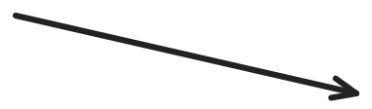
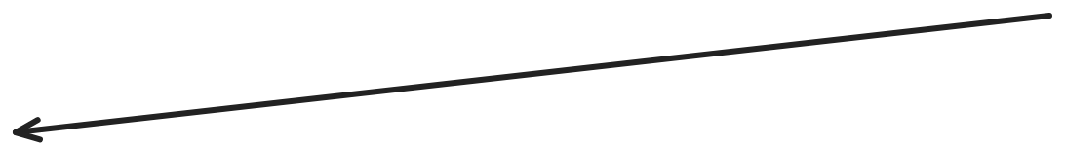

Block Styles
Use end-of-line style for braces.
Next-line
style
public class Test
{
public static void main(String[] args)
{
System.out.println("Block Styles");
}
}
End-of-line
style
public class Test {
public static void main(String[] args) {
System.out.println("Block Styles");
}
}
OOP · Lab 1 · Java basics · 22
Notes:
Both compile; use end-of-line. Ctrl+Shift+F formats in Eclipse.

Slide 23
Classes and Primitive Types
Type
▫ Class
▫ Primitive type
class Exam {}
int, char, float
Instance
▫ Variable of type reference
▫ Variable of type primitive
Exam e;
e = new Exam();
int i;
OOP · Lab 1 · Java basics · 23
Notes:
A reference variable points to an object; a primitive holds the value.

Slide 24
Operators
▫ Operators follow C syntax:
– arithmetical + - * / %
– relational == != > < >= <=
– bitwise (int) & | ^ << >> ~
– assignment = += -= *= /= %= &= |= ^=
– increment ++ --
OOP · Lab 1 · Java basics · 24
Notes:
/ between two ints drops the floating point

Slide 25
Boolean
▫ Java has an explicit type (boolean) to represent logical values (true, false)
▫ Conditional constructs require boolean conditions
– Illegal to evaluate an integer condition
int x = 7; if (x) {…} // NO
– Use relational operators: if (x != 0)
– Avoids common mistakes, e.g. if (x = 0)
OOP · Lab 1 · Java basics · 25
Notes:
if (x = 0) does not compile

Slide 26
Control Statements
▫ Similar to C
– if-else
– switch
– while
– do-while
– for
– break
– continue
OOP · Lab 1 · Java basics · 26
Notes:
Same as C

Slide 27
Switch Statements with Strings
▫ Strings can be used as case values
switch (season) {
case "summer":
case "spring": temp = "hot";
break;
}
– The compiler generates more efficient bytecode from a switch on Strings than from chained if-then-else statements
OOP · Lab 1 · Java basics · 27

Slide 28
Code Blocks and Scope
▫ Java code blocks are the same as in C
▫ Each block is enclosed by braces { } and starts a new scope for the variables
▫ Variables can be declared both at the beginning and in the middle of a block
for (int i=0; i<10; i++) {
int x = 12;
...
int y;
...
}
OOP · Lab 1 · Java basics · 28
Notes:
Variables disappear when their block ends

Slide 29
Passing Parameters
▫ Parameters are always passed by value
▫ ...they can be primitive types or object references
– Note: only the object reference is copied, not the whole object
OOP · Lab 1 · Java basics · 29

Slide 30
Programming Errors
▫ Syntax Errors
– Detected by the compiler
▫ Runtime Errors
– Causes the program to abort
▫ Logic Errors
– Produces incorrect result
OOP · Lab 1 · Java basics · 30
Notes:
Which kind is the most dangerous? Logic errors, because nothing tells you, not even LLMs.

Slide 31
Syntax Errors
public class ShowSyntaxErrors {
public static main(String[] args) {
System.out.println("Welcome to Java);
}
}
▶ Try it live ↗
OOP · Lab 1 · Java basics · 31

Slide 32
Runtime Errors
public class ShowRuntimeErrors {
public static void main(String[] args) {
System.out.println(1 / 0);
}
}
▶ Try it live ↗
OOP · Lab 1 · Java basics · 32

Slide 33
Logic Errors
public class ShowLogicErrors {
public static void main(String[] args) {
System.out.println("Celsius 35 is Fahrenheit degree ");
System.out.println((9 / 5) * 35 + 32);
}
}
T(°C) = (T(°F) − 32) / (9/5)
▶ Try it live ↗
OOP · Lab 1 · Java basics · 33

Slide 34
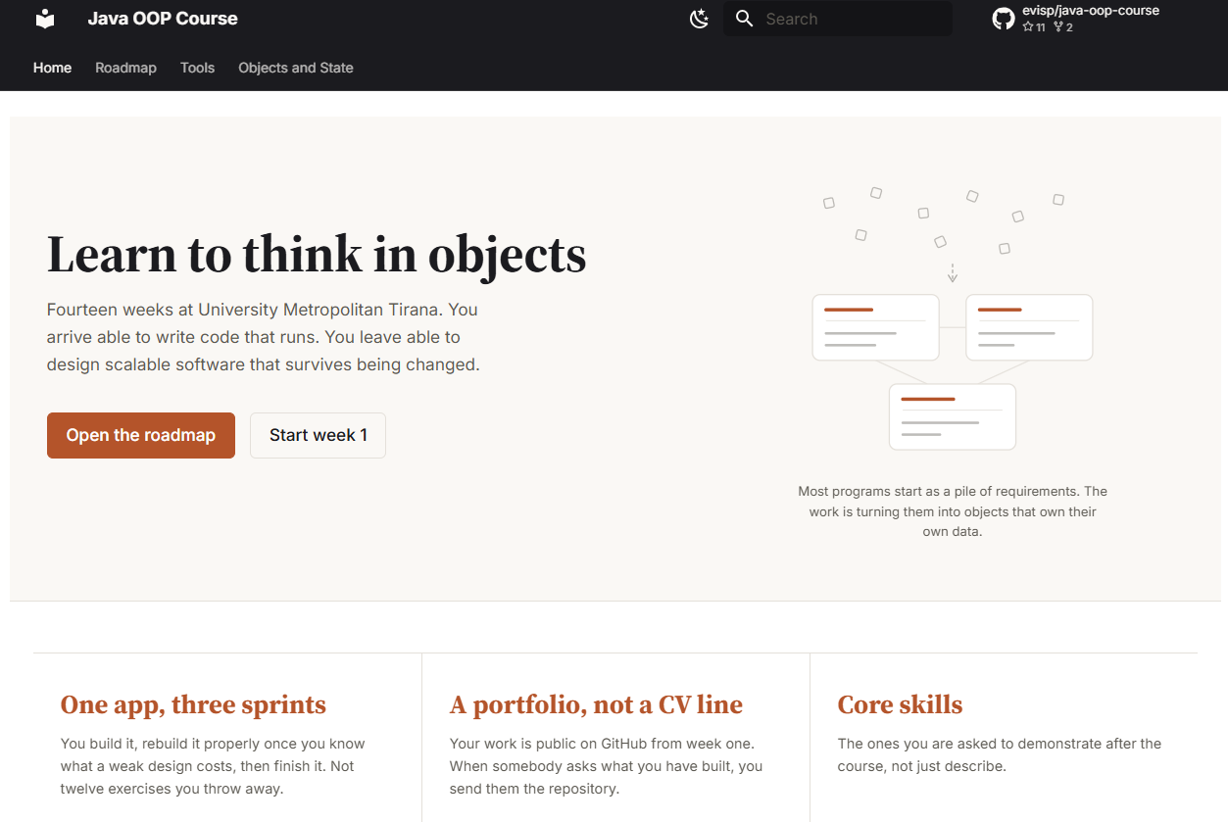
https://evisp.github.io/java-oop-course/

